Slide 1
Starting with Conversations as a Platform
Brijraj Singh
Sr. Software Engineer (CSE)
Microsoft
Notes:
Put your details above.
Each slide contains example script in the notes. Once confident with the content, you can use the headings in the notes as cues to ad-lib the content in your own words.

Slide 2
The ‘Hotel Finder bot’
Initial prompt
Get input
If ‘Help’
Get input
Call LUIS
Call LUIS
Provide result
Notes:
Now we want to register for use of Bing Spell check and Linguistic Analysis to use in the application.

Slide 3
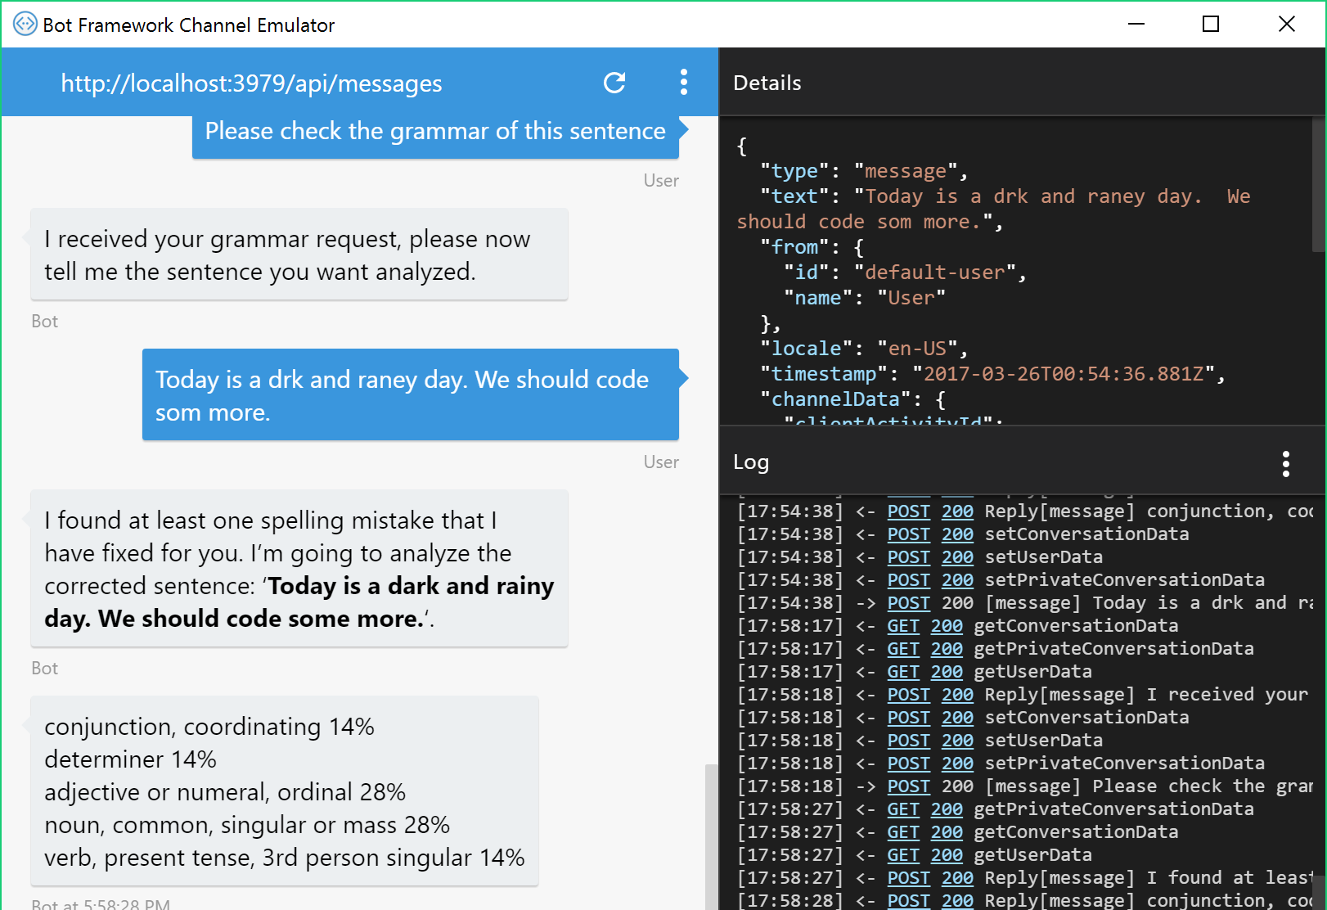
The Tools
Bot Framework SDK for .NET
Bot Framework SDK for node.js
Emulator
Azure (or any website) for hosting
Registration portal
Notes:
Let’s get started and look at the tools.
Microsoft provides the bot framework to help get started very quickly with bot development.
Using the Bot Framework SDK for .NET, you can built a bot that runs in the ASP.NET framework. It can run on your machine or be hosted in the cloud.
Equally there’s an SDK for node.js too, so you can host your bot in either of these frameworks to suit your skillset.
The Emulator is a tool which connects to your locally or cloud-hosted bot, providing a basic channel in which you can test your bot without it even needing to be registered.
When you are ready to publish your bot, Azure provides a highly available and scalable option for hosting, starting with free tiers. You can host both .NET and node.js bots there.
When you’re ready to present your bot to the world, you go to the registration portal where you declare your bot with a unique name and register the cloud-based end-point to which you published your bot. You also decide which channels will be available for users to use the bot.
We’re going to do all of this in the following demos.

Slide 4
The ‘Hotel Finder bot’
Initial prompt
Get input
If ‘Help’
Get input
Call LUIS
Call LUIS
Provide result
Notes:
Now we want to register for use of Bing Spell check and Linguistic Analysis to use in the application.

Slide 5
The Cognitive Services
Vision | Speech | Language | Knowledge | Search
Computer Vision Content Moderator Custom Vision Service PREVIEW Emotion API PREVIEW Face API Video Indexer | Speech Service Bing Speech API Custom Speech Service ^{PREVIEW} Speaker Recognition ^{PREVIEW} Translator Speech | Bing Spell Check Language Understanding (LUIS) Linguistic Analysis ^{PREVIEW} Text Analytics Translator Text Web Language Model ^{PREVIEW} | Academic Entity Linking Knowledge Exploration QnA Maker Recommendations | Bing News Search Bing Video Search Bing Web Search Bing Autosuggest Bing Custom Search Bing Entity Search Bing Image Search Bing Visual Search
Notes:
LUIS is part of the Language APIs available within Cognitive Services.
We are focusing on these language APIs for this application.

Slide 6
Demo
Setting up LUIS
Notes:
Demo 2.2
Now let’s see how you get started with setting up LUIS to be able for use in things like your bot

Slide 7
The ‘Hotel Finder bot’
Initial prompt
Get input
If ‘Help’
Get input
Call LUIS
Call LUIS
Provide result
Notes:
Now we want to register for use of Bing Spell check and Linguistic Analysis to use in the application.

Slide 8
Demo
Add some other Cognitive Services
Notes:
Demo 2.3
Let’s add spell checking and linguistic analysis to our bot.

Slide 9
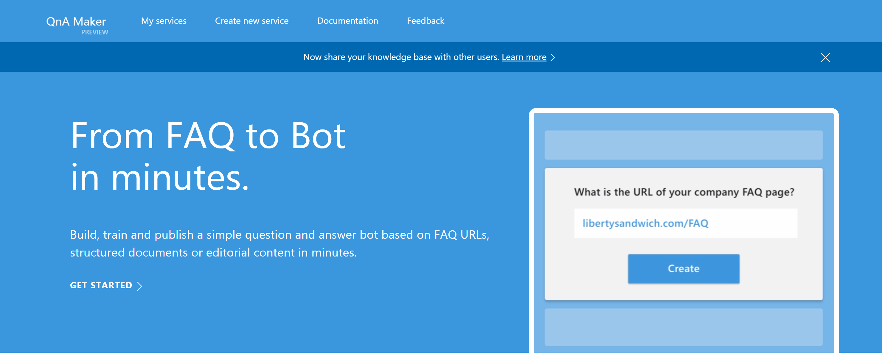
Knowledge Base Bots and QnA Maker
#MSBuild

Slide 10
QnA Maker

Slide 11
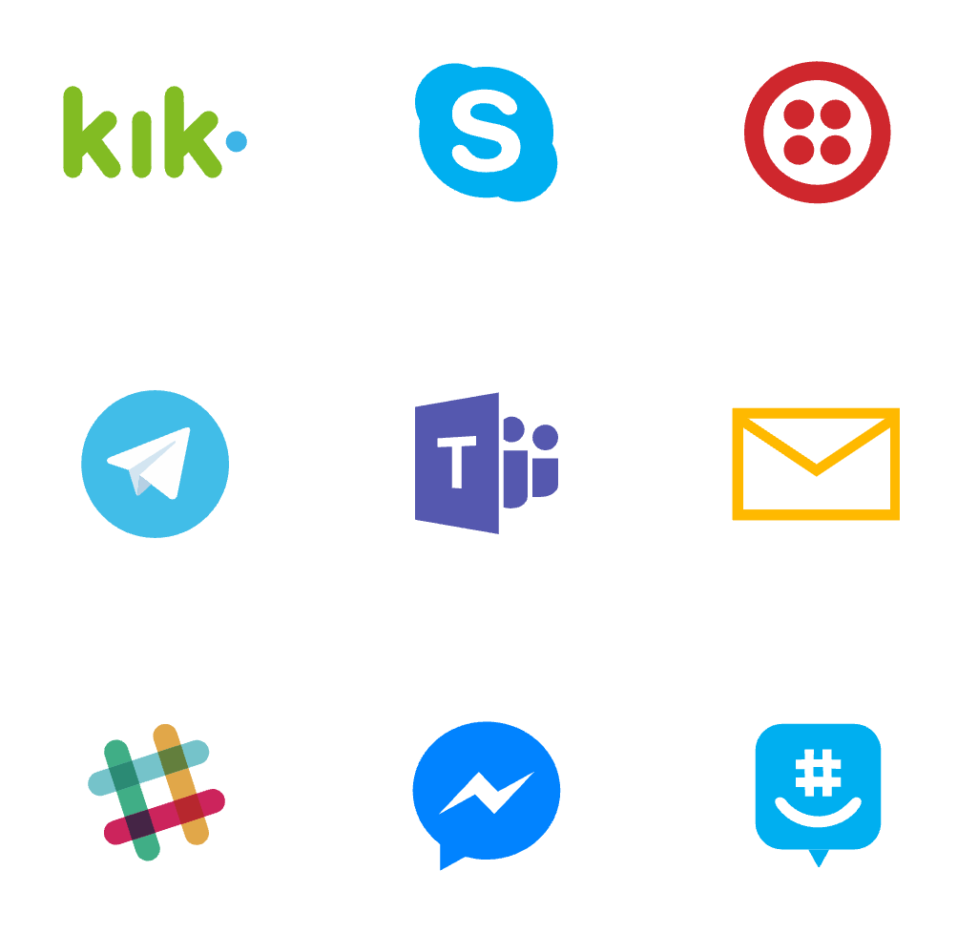
Where bots live
Notes:
Here’s a recap on the array of channel for bot participation.

Slide 12
Demo
Rich Responses
Notes:
Demo 2.6

Slide 13
But... Do you really need a bot?

Slide 14
Bots don’t inherently solve all problems
Address your core issues first
Determine if a different type of app might be appropriate
How will this be different from your existing website/mobile app/desktop app?

Slide 15
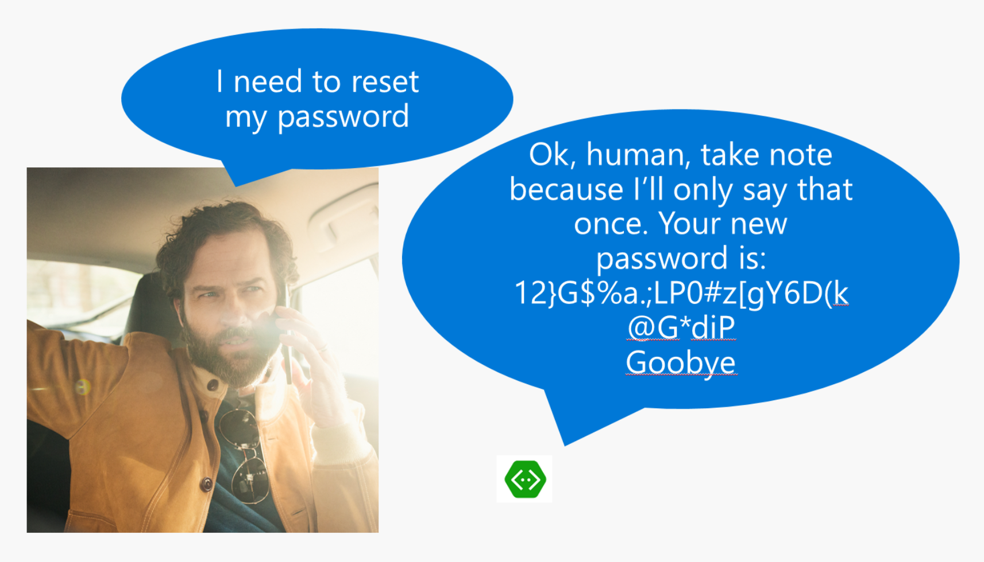
Anti-pattern: Canvas/input mismatch

Slide 16
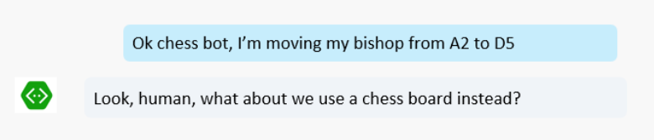
Anti-pattern: Canvas/input mismatch

Slide 17
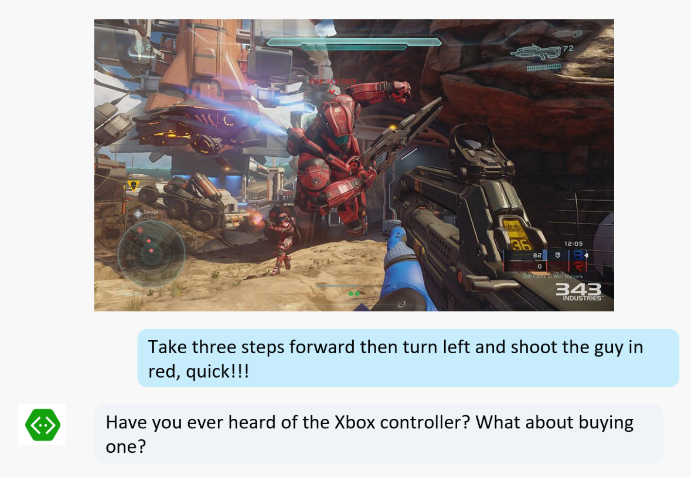
Anti-pattern: Canvas/input mismatch

Slide 18
Using the right interface

Slide 19
Common patterns

Slide 20
Knowledge Base Bots
Bots that can reason over a corpus of data to find and return a piece of information
Event bots, Help Desk bots, Contact bots, etc.
#MSBuild

Slide 21
Handoff to Human
Every company deals with this:
First triage/data collection
Simple and repetitive solutions
Customer call
Complex cases and escalation

Slide 22
Backchannel
Backchannel is the practice of using maintaining a real-time online conversation alongside the primary group activity or live spoken remarks

Slide 23
The labs

Slide 24
Introducing the labs
All based on real world scenarios
Blend of guided experience and hackfest
Clone the repo here https://github.com/munishmalhotra/operation-max
Each lab contains
Detailed user stories
High-level steps
Step by step instructions
If you feel unsure about what to do
Further challenges
Take your bot to the next level

Slide 25
Resources
Download Labs - https://github.com/munishmalhotra/operation-max
Download Emulator:
V3 - https://github.com/Microsoft/BotFramework-Emulator/releases/tag/v3.5.36
V4 - https://github.com/Microsoft/BotFramework-Emulator/releases
Docs & getting started –
https://dev.botframework.com/
https://docs.microsoft.com/en-us/azure/bot-service/nodejs/bot-builder-nodejs-quickstart?view=azure-bot-service-3.0
https://docs.microsoft.com/en-us/azure/bot-service/?view=azure-bot-service-4.0
Webchat control - https://github.com/Microsoft/BotFramework-WebChat
Learn and try Cognitive Services at - https://www.microsoft.com/cognitive-services
Notes:
As shown

